Slide 1
Motion Priors
Towards automated MoCaP
Luke Smith

Slide 2
Introduction

Slide 3
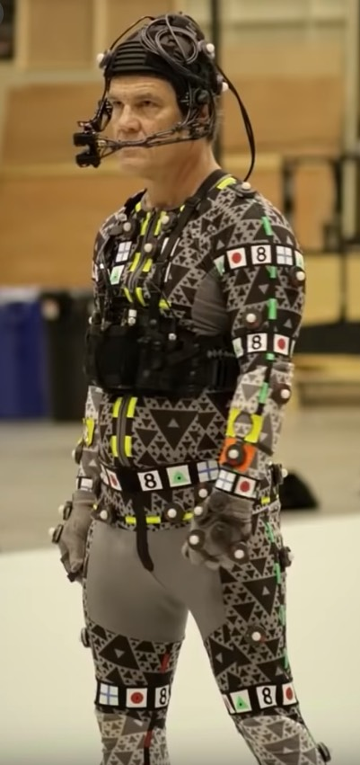
Context
Ultimate goal
Automated MoCap system
RGB video -> realistic motion
No clunky suits

Slide 4
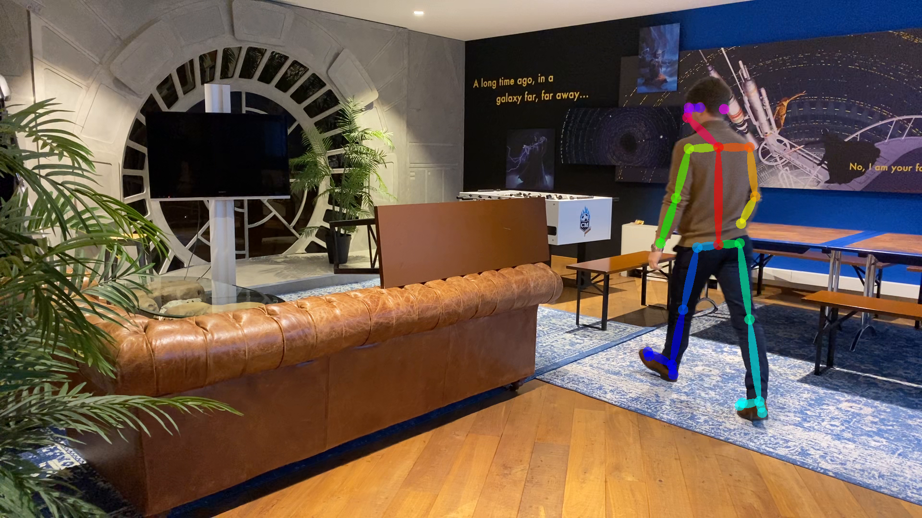
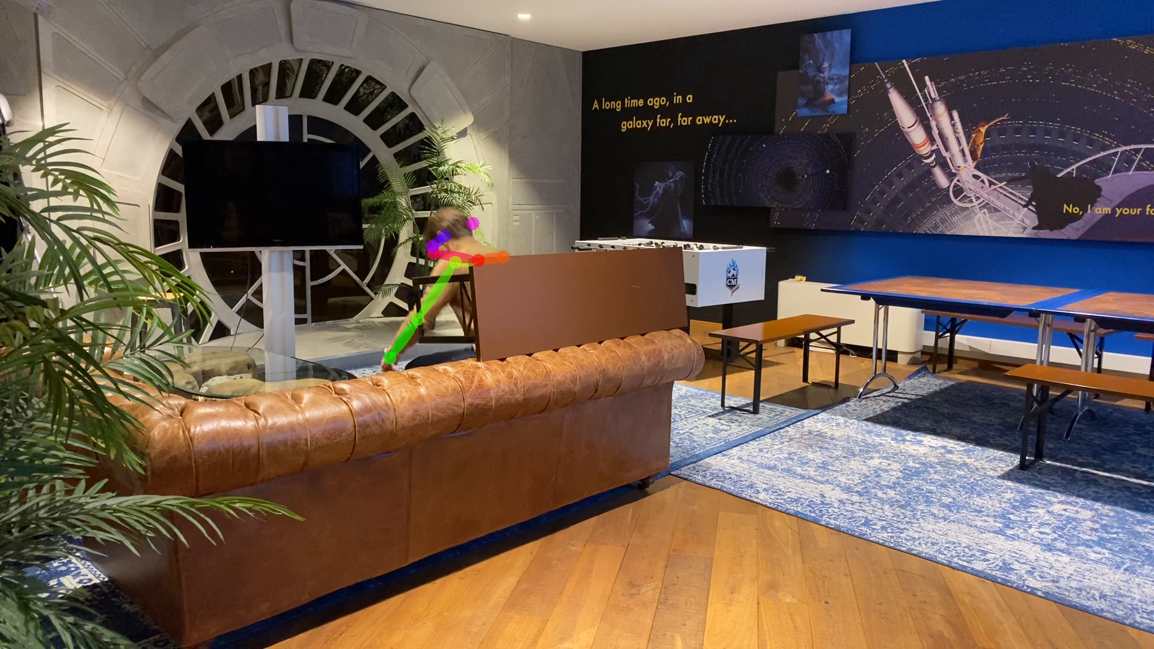
Current system
Per-frame prediction
Per frame pose predictions
Issues
Temporally uncorrelated => jitter
Trouble with occlusions
Adopted solution
Optimise the sequence of poses with smoothness losses
Occlusion issues

Slide 5
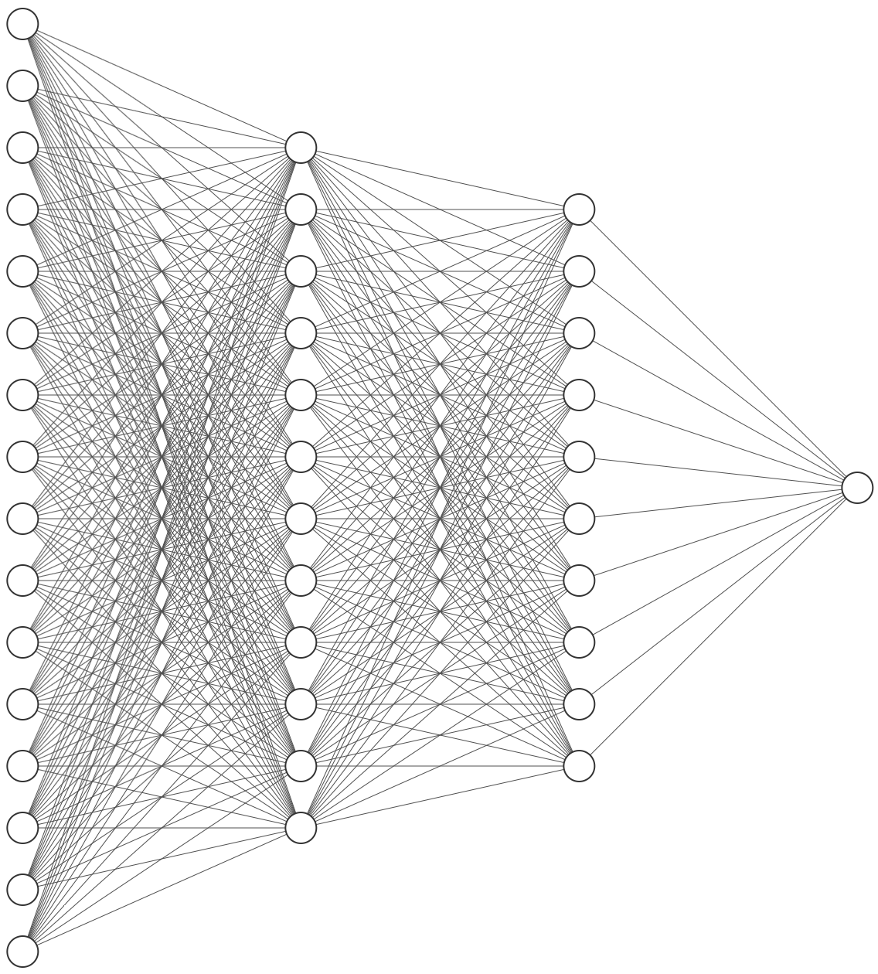
Motion Priors
Motion prior?
A model that has learnt how humans move
e.g. through next pose prediction
And then what?
Constrain a sequence of pose estimations using the prior

Slide 6
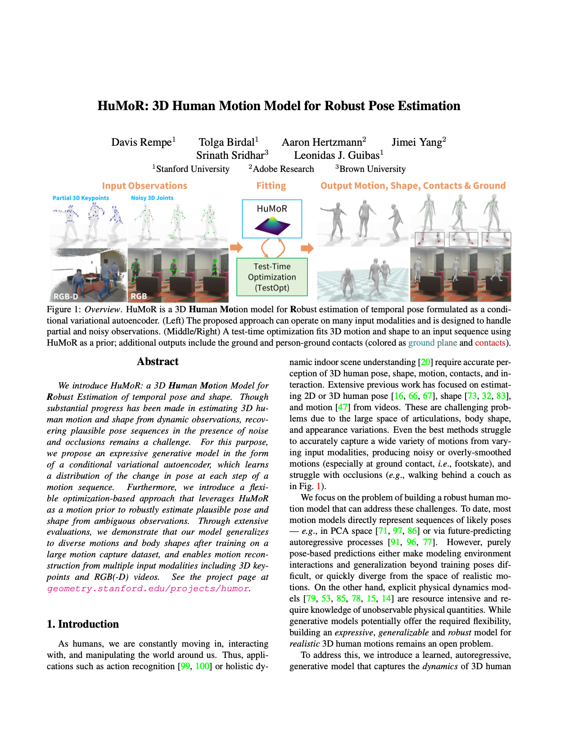
HuMoR Paper
‘Human Motion Model for Robust Estimation’
Paper describes:
Motion prior model
Use in improving frame-by-frame pose predictions
Used as a starting point for my project

Slide 7
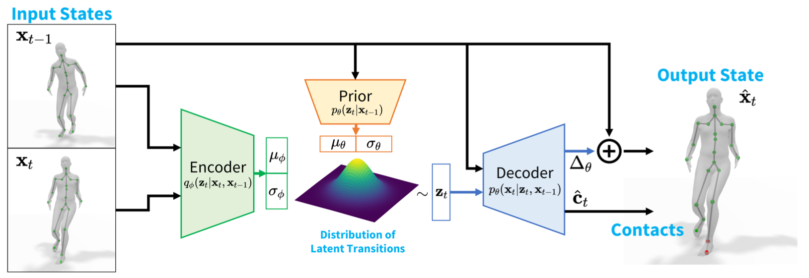
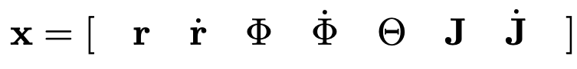
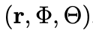
HuMoR
1. Motion Prior
Conditional VAE
Change in state
Model
Velocities
State
Note
Root translation
Joint positions
Root orientation
Body pose (joint angles)
Parametrises the small model

Slide 8
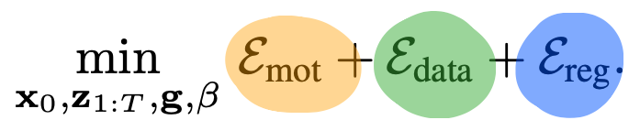
HuMoR
2. Motion optimisation: objective
Reprojection to 2d joint predictions
Objective
Given a sequence of 2d pose estimations
Likelihood of latent transitions and initial state
Various regularisers

Slide 9
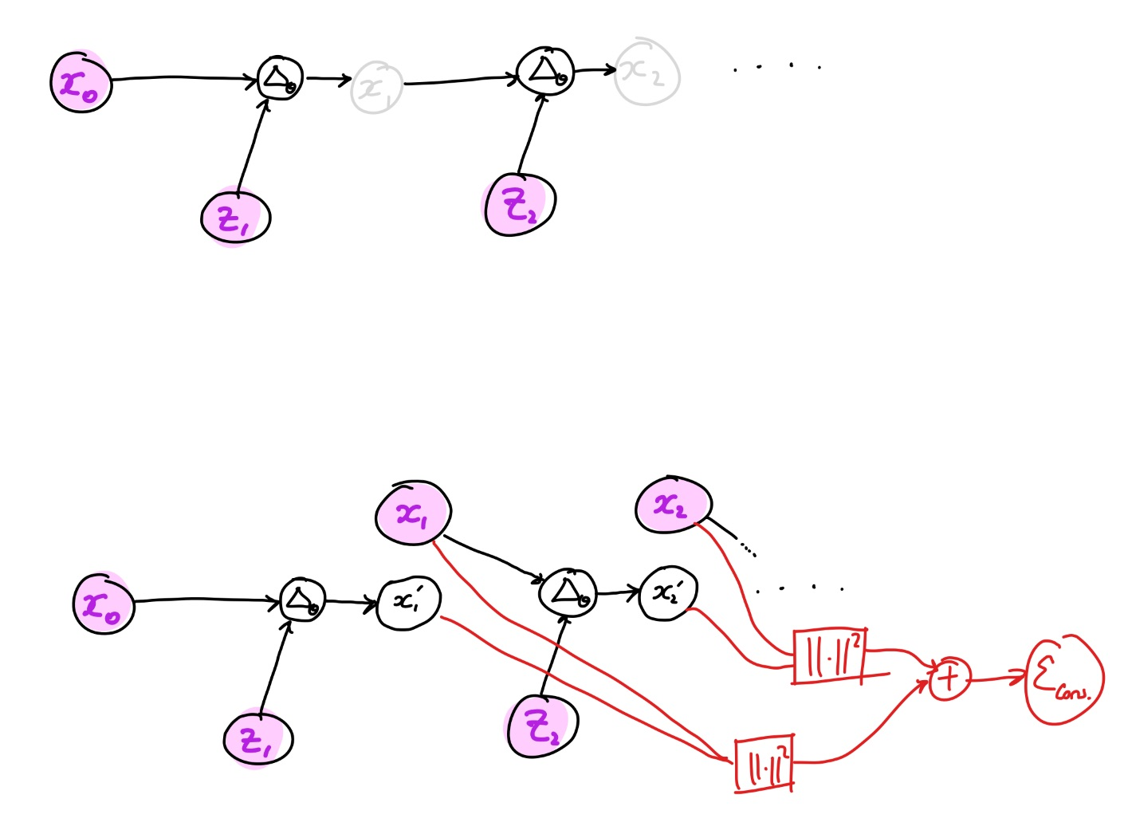
HuMoR
2. Motion optimisation: more concretely
Rollout
What we apply the loss terms on

Slide 10
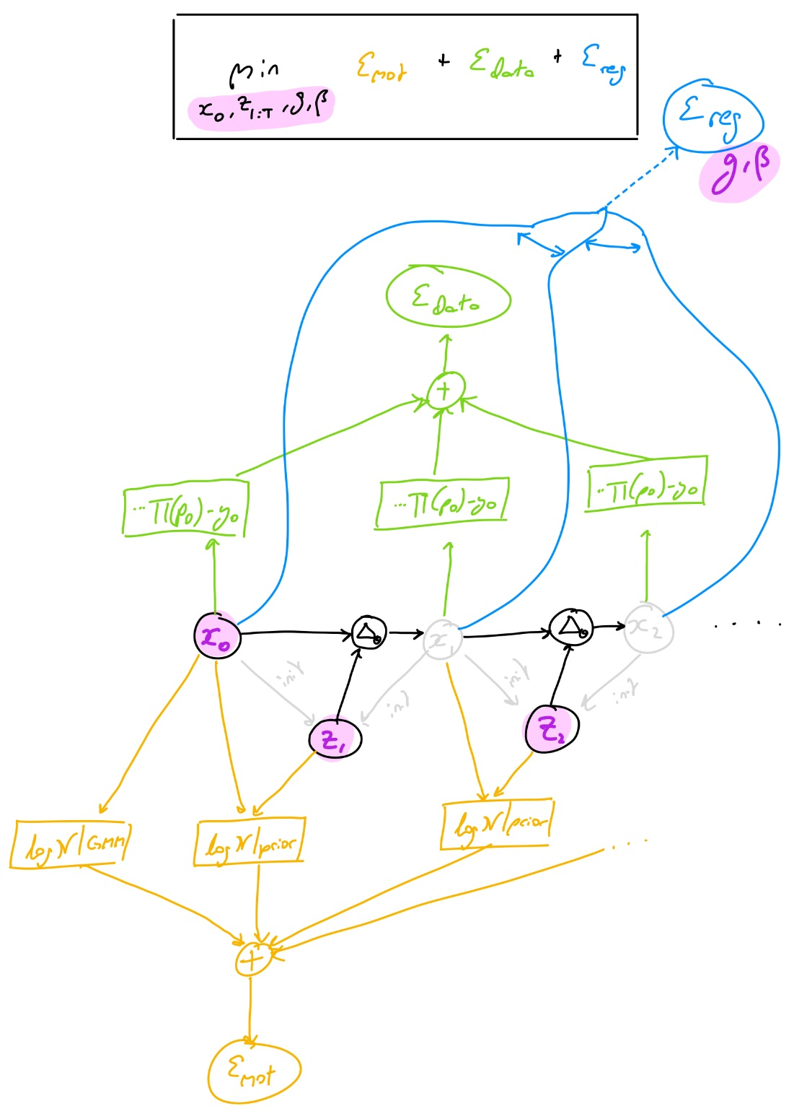
HuMoR
2. Motion optimisation

Slide 11
What I’ve been up to

Slide 12
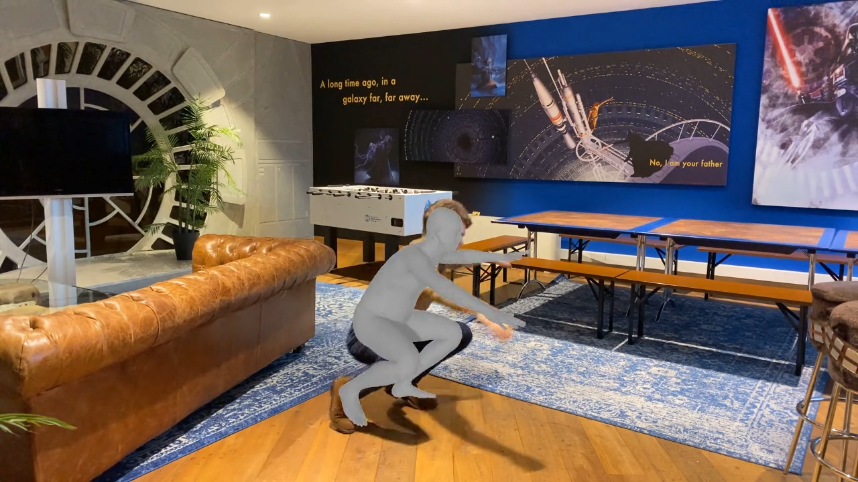
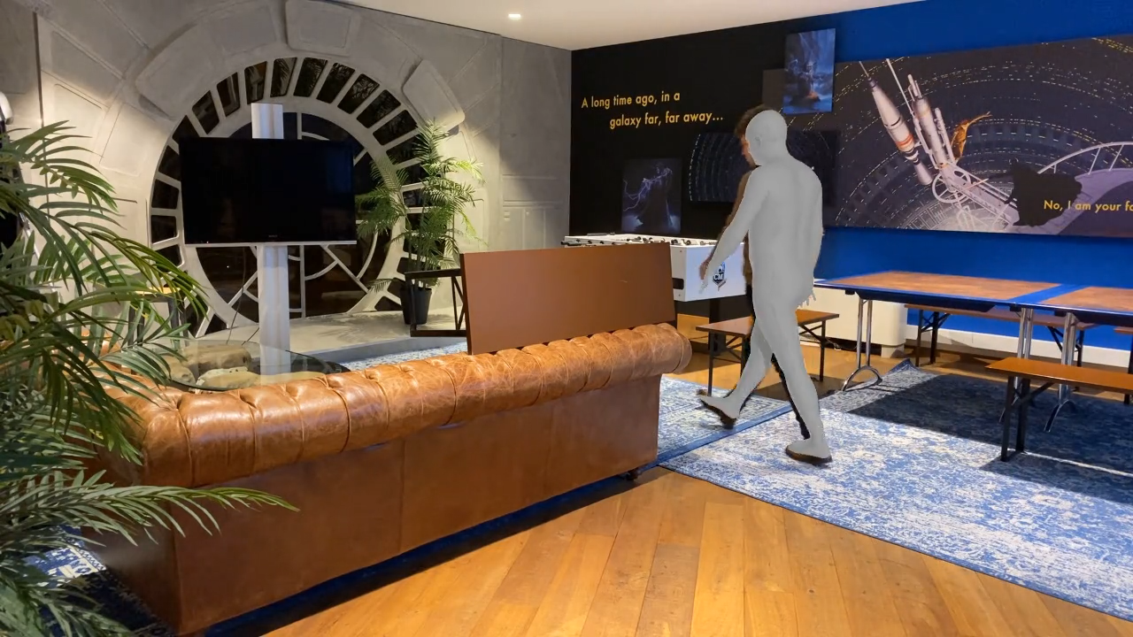
HuMoR Evaluation
The good
Smooth motion
Nice occlusions

Slide 13
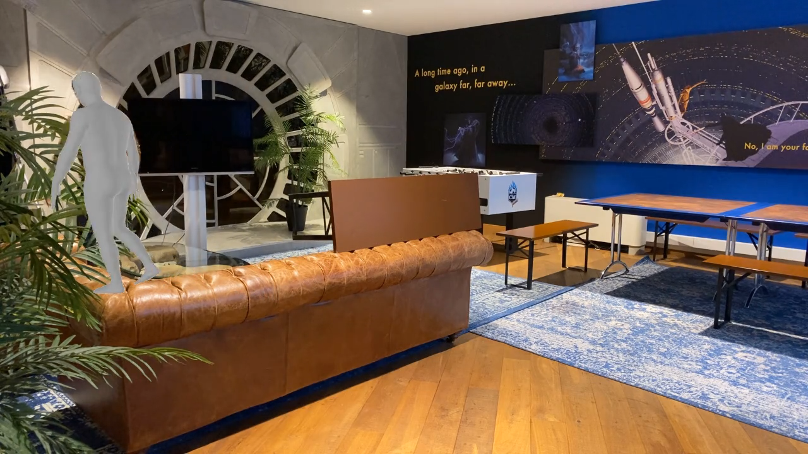
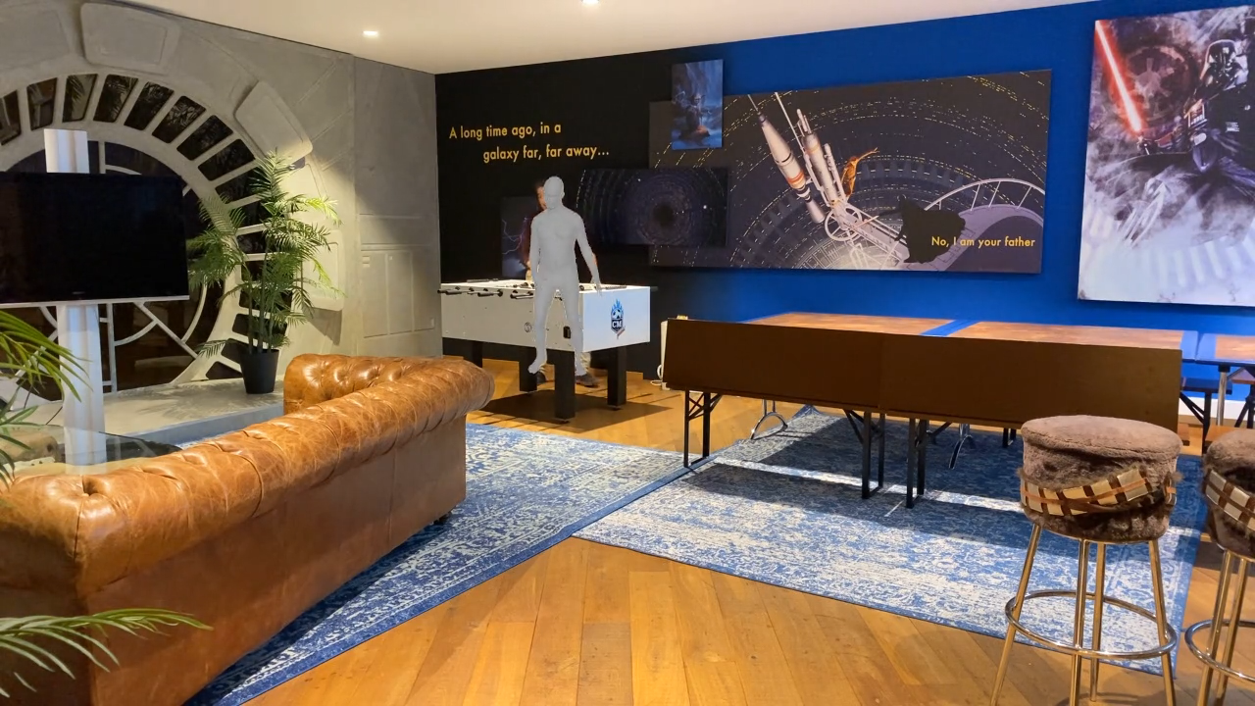
HuMoR Evaluation
The bad
Angle representation issues
Not so nice occlusions

Slide 14
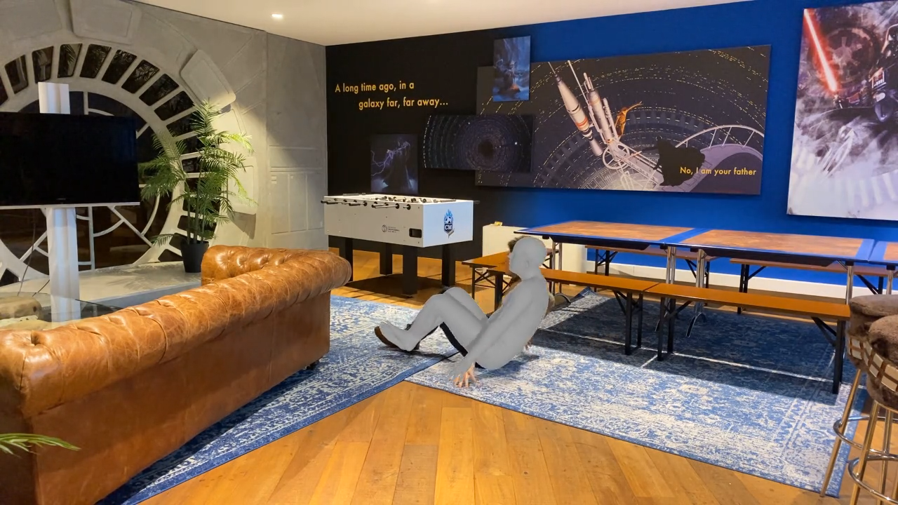
HuMoR Evaluation
The worse
Out of distribution motion…

Slide 15
HuMoR Evaluation
Comments
Issues
Unusably slow
20+mins for 8s video
Issues with angle representation
Evaluation didn’t result in a clear yes/no decision
Improves results in some occluded situations
Seems worth investigating
Issue 1 is to be addressed first
Not viable without speedup

Slide 16
HuMoR Evaluation
Why so slow?
Profiling revealed the ‘rollout’ is the issue
Rollout is slow
Rollout results in large computation graph
Backward step is slow

Slide 17
HuMoR Improvement
How to speedup
With rollout
Without rollout
Idea of Jakobs’

Slide 18
HuMoR Improvement
Implementation
I have largely implemented this new method
Currently trying to get it do something useful
Bug fixing
Investigating the different losses
Considering new losses

Slide 19
What’s next?
Finish the new optimisation method
Decide if it’s viable
If so
Work on improving the motion model
Relies on SMPL, which we won’t use
Idea of GNN’s
If not
Other ways to use the HuMoR prior?
More paper reviews?
Pivot to a new direction?

Slide 20
Questions/Comments?

